Slide 1
CSE534 presentation
Tianyao Luo
Anni Du
Yishuo Wang

Slide 2
Incast Congestion Control for TCP in DC
Problem: In data center, many server send to one server parallel at the same time, which cause the packet loss.
Environment: NS-3(recommended by prof)

Slide 3
Idea
First, we will do simulate the problem will lose in data center. Record the data
Second, we will follow the paper to do the ICTCP. Using the way we get data in the first step. Record the data.
Third, we tried to improve for changing the congestion window size. Record the data again.
Fourth, compare these three group of the data to analyze.

Slide 4
A little detail
In the NS-3, we will simulate the case and output the .pcap file.
Then we can use .pcap file to analyze by using wireshark and the Homework 2 experience.

Slide 5
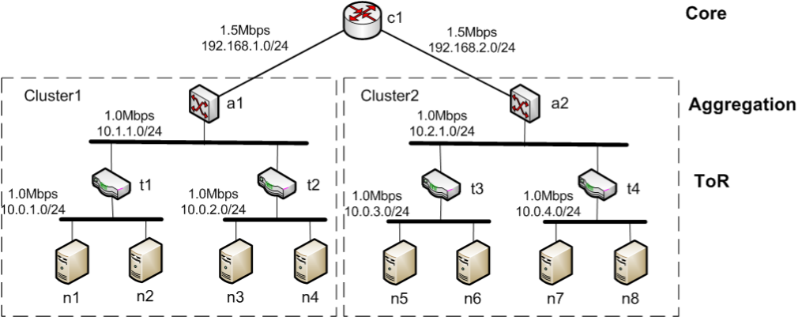
Topology(7 server send to one server)

Slide 6
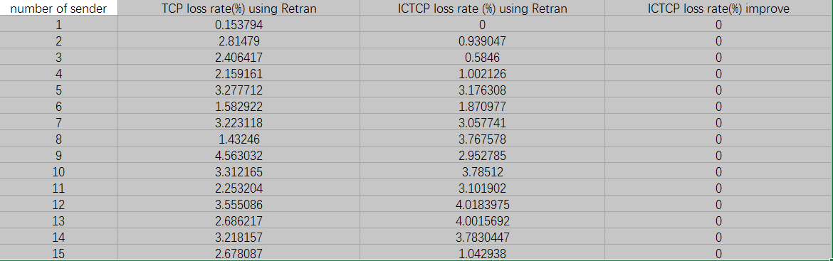
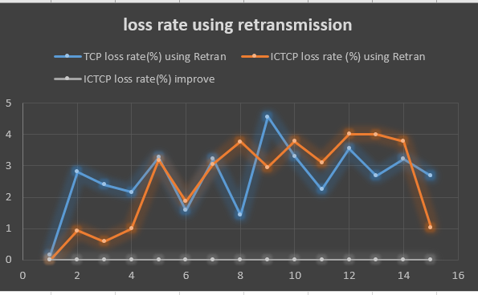

Slide 7
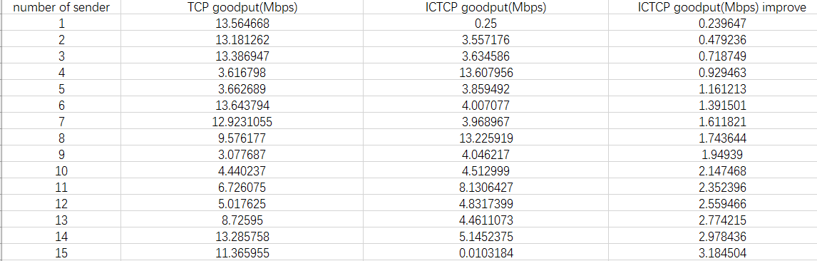
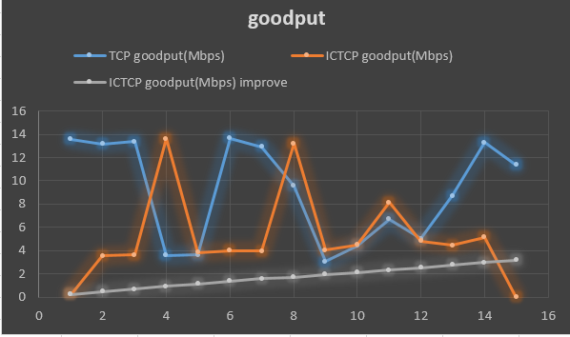

Slide 8
